Slide 1
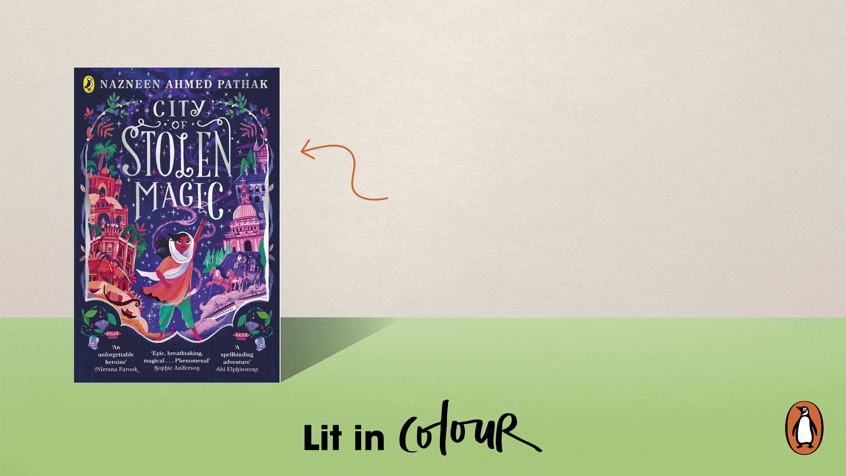
City of Stolen Magic
by Nazneen Ahmed Pathak
Middle Grade

Slide 2

Character/Theme Questions
What is the most magical shape? Why?
What is the most magical object? Why?
What is the most magical metal? Why?
If you could have a magical superpower, what would it be and why?
What makes a hero/heroine heroic?
Activity 1
Pre-reading:
Class discussion
Share your ideas
Challenge
Imagine and create your own hero/heroine. What is their origin story? What obstacles have they had to overcome or face? Have they had to transform? Describe their nemesis or villain.

Slide 3
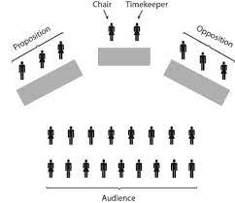
Character/Theme Questions
“It is always wrong to tell a lie.” To what extent do you agree with this statement?
Activity 2
Debating
Class/group debate

Slide 4
Character/Theme Questions
Why is it important to know where words come from?
Where do these words come from?
    Veranda
    Bungalow
How can you use different languages to explore different stories?
What can you understand about a country’s history from words in the language?
Challenge: How do you think colonialism has shaped the use of language across the world?
Activity 3
Etymology
Class/group debate

Slide 5

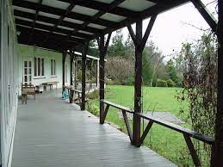
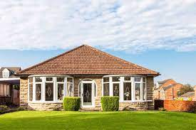
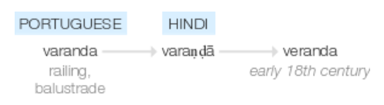
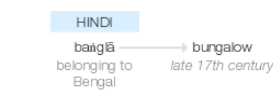
Veranda
Language and structure questions
Portuguese
Varanda = railing or balustrade
Hindi
बरामदा
vəˈrandə
Late 18th century
Modern English
Veranda =
Porch outside a building
Bungalow
Hindi
बंगला
Late 17th century: from Hindi baṅglā ‘belonging to Bengal’, from a type of cottage built for early European settlers in Bengal.
Modern English
A low storey building with one floor

Slide 6
Language and structure questions
Why is it important to learn different languages?
How many languages do you speak? Even if you know a few words, e.g. how to count to ten.
Activity 4
Languages
Class discussion
Draw a pie chart with languages you can speak
Share with the class

Slide 7
She raised her hand and, for the first time in her life,
hailed a rickshaw. A cyclist slowed and raised his head in
enquiry.
‘Old Dacca Chowk Bazaar’ she said haughtily, with a
deeply satisfyingly rush of grown-
upness.
The breeze blew playfully through Chompa’s hair as the
rickshaw wheeled along the wide streets, darting and
weaving between the lumbering horse-
Drawn carriages like a little silver fish. Leeza grabbed Chompa’s waist tightly as she waved her hand through the air.
‘You should hold the edge of the hood. Any bump and
you’ll go flying into the street
– and how will we explain your injuries, huh?’
‘Chup- chup, Leeza, I’m fine. I won’t fall!’
Chompa pulled herself up to standing, both hands
reaching up to the sky. The rickshaw- wallah muttered in
rough, accented Bangla to Leeza.
‘He’s agreeing with me – sit down. He thinks you might be mad. I know you are.’
Extract 1
Class Reading
Chapter 13, p108 - 109
Challenge
Make up actions to go along with the reading of the text.
Magpie words and highlight phrases you can use in a diary entry/travel blog

Slide 8
Soon the streets started to narrow, and the buildings
became disordered, tumbling structures of tiles, brick,
aluminium
– anything that was spare, cheap and would hold off heavy monsoon rains. And people
– suddenly there were people everywhere. It didn’t seem possible, but the
noise seemed to grow louder as they approached a slightly
more uniform set of buildings packed into a tight grid. The
rickshaw slowed to a stop. Chompa jumped out and paid the driver. Her nerves thrilled with excitement.
Extract 1
Class Reading
Chapter 13, p108 - 109
Challenge
Make up actions to go along with the reading of the text
Magpie words and highlight phrases you can use in a diary entry/travel blog

Slide 9
‘I should have stayed with her . . . I shouldn’t have let
anything stop me . . .’ she whispered.
Leeza patted Chompa’s shoulder. ‘Let’s have a look around.
Maybe we’ll find that message.’
The girls picked their way carefully through the chaos in
the hut. There was torn, shredded paper everywhere, fibres
even floating in the air, making them cough. The floor was
carpeted with the empty covers of books that had had their
pages brutally ripped from them, and little metal cubes with
digits and characters on them were scattered everywhere.
Leeza gathered up heaps of paper, sorting them into
colours. Chompa tried to piece bits together. But the paper
had been shredded and crushed, and there was so much of it,
it was impossible. Chompa felt tired and lost in the face of
some huge, violent danger that just kept taking things away
from her, for no reason she could fathom. Devaynes.
‘There’s nothing here,’ said Leeza, tugging at Chompa’s
arm. ‘Let’s go – it’s not safe.’
Extract 2
Class Reading
Extract Two: Chapter 14 – p.120 - 121
Challenge
Make up actions to go along with the reading of the text
Magpie words and highlight phrases you can use in a diary entry/travel blog

Slide 10
But Chompa didn’t move, just stared at the piles of paper.
She thought that some had been posters, others the pages of
spellbooks ready to be stitched together. ‘This was Ammi’s
work. I can’t just leave it like this.’
Her fingers closed round the pair of taviz in her pocket.
The cool touch of the etched silver, made by her mother’s
hands, seemed to awaken her. She snapped her eyes open.
Paper was made from trees, and trees had been alive once.
There were fibres still streaming all around, and Chompa could
almost sense the pulsing pain of the dying books within them.
There was energy in the pages, in the fibres dancing in the light.
She could work with energy.
She trained her eyes on one of the shreds, and ran her
fingers through the soft, feathery heaps around her. She
unwove the knotted fibres in her mind, focusing on the idea
of healing. She didn’t know if the spell would return the
fibres to paper or tree form, but she had to try.
Paper began to swirl like leaves during monsoon round
Chompa’s still form, until she was almost completely
concealed by a greyish-white swarm.
Extract 2
Class Reading
Extract Two: Chapter 14 – p.120 - 121
Challenge
Make up actions to go along with the reading of the text
Magpie words and highlight phrases you can use in a diary entry/travel blog

Slide 11
Leeza stopped her browsing of the paper and watched,
mesmerized.
Chompa brought her hands together.
Leeza’s eyes grew huge in the half-
Light as the pieces of paper looked, actually looked, for their sister selves
– there was no other way to describe it. They flurried and turned
away from some, and moved towards others, gradually
drawing together in the air in little clouds.
Then Chompa unlaced her fingers, straightened her hands
into flat palms, and laid one on top of the other. The clouds
trembled and unravelled, winding themselves into flat,
almost perfect pieces of paper.
Leeza clapped her hands together and cackled with glee,
making Chompa snap back into focus. Together, they watched
the pages waft gently to the ground, settling themselves into
neat little piles as they did so.
Extract 2
Class Reading
Extract Two: Chapter 14 – p.120 - 121
Challenge
Make up actions to go along with the reading of the text
Magpie words and highlight phrases you can use in a diary entry/travel blog

Slide 12
Character/theme through language
A) Write a diary entry as if you are Chompa:
Describe your journey
Use sensory description to build atmosphere
Describe the mode of transport and movement
Describe the weather and nature to build mood
Include references to Chompa’s magical powers
Include details about her relationship with Leeza
Challenge: imagine and explore why Chompa hates Devaynes
OR
B) Write a travel blog:
Imagine you are moving through a bazaar or market in another country. You could imagine you are in “Old Dacca Chowk Bazaar”
Create a headline for your article
Use sensory description to build imagery of the scene
Use dialogue to create aural imagery of the noise
Describe people in the space
Describe the weather and nature to build mood
Draw an image and caption
Challenge: offer advice/top tips to travellers coming to the area
Activity 5
Writing
Challenge
Can you include instances of other languages you speak or know or have learned from the extract?

Slide 13
Editing
Self-reflection checklist:
Read your work aloud to yourself
Reduce number of words and rephrase: can you describe or say what you want with less words?
Improve vocabulary: underline words which you want to improve. Use a dictionary or thesaurus to improve your vocabulary choices
Add linguistic detail: have you included any words/phrases from another language? Would this help to develop the overall impression of the character you’re trying to create?
Improve punctuation: are your sentences varied and accurately punctuated? Check full stops, capital letters, commas and exclamation marks
Develop voice: have you included dialogue to help develop character voice?
Have you started a new paragraph for a new topic, time and/or place? TiPTop
Activity 6
Editing
Self-reflection checklist
Challenge
Could you use a semi-colon to join independent clauses?

Slide 14
Editing
Peer-assessment checklist:
Read your partner’s work aloud
Do you think the vocabulary could be improved? Underline words which you think could be changed/improved
Do you think they could improve punctuation? In the margin make suggestions about how they could use: exclamation marks, speech marks, commas, semi-colons.
Do you think your partner could develop the structure of their writing? Add // to where you think they could add a paragraph
Write a comment about your favourite aspect of their writing. I think this was effective or interesting because…
Activity 7
Editing
Peer-assessment
Challenge
Can you suggest where they could include a one-line paragraph (a standalone sentence paragraph)?

