Slide 1
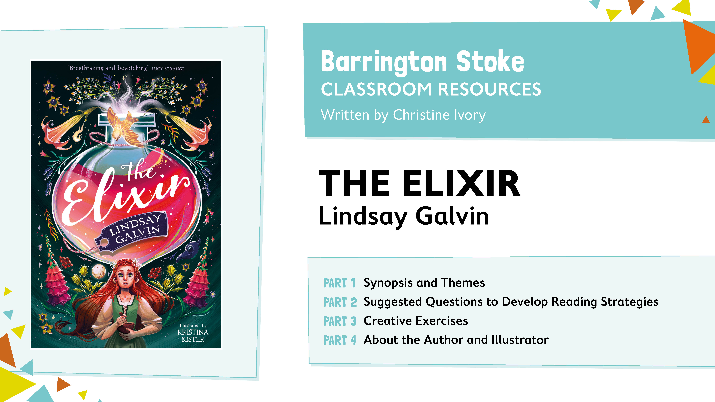

Slide 2
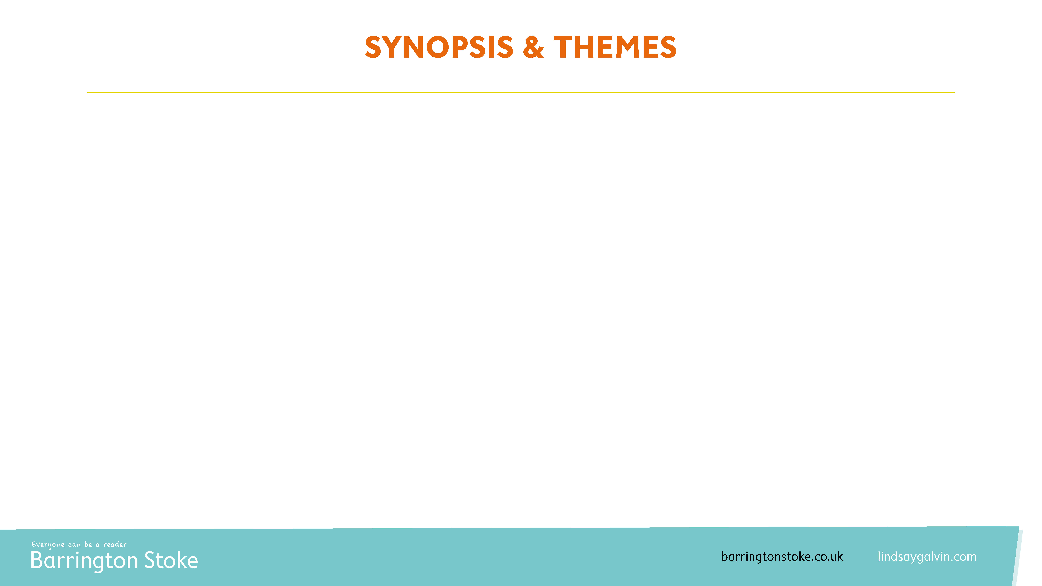
The following slides provide questions and activities to be completed alongside study of Lindsay Galvin’s The Elixir; a high-stakes adventure that blends fiction with the real history of 17th century witch trials, the plague, and inventor Isaac Newton.
SYNOPSIS
Ann Storer has inherited her grandmother’s mysterious gift of healing, which she shares through the special tinctures she dispenses in her family’s apothecary shop. When she combines her talents with the genius of a young Isaac Newton, recently arrived to board above the shop, the two create an incredible elixir with seemingly unlimited powers. But seventeenth-century England is a dangerous place to display any special abilities, and Ann must hide all evidence when witchfinder Abel Geach arrives in town. So when the plague starts to run rife and those she loves are in danger, will Ann risk everything to help them?
Before you begin reading, discuss as a class: what sort of themes do you think the story will cover? What do you think Ann will be like as a character?

Slide 3
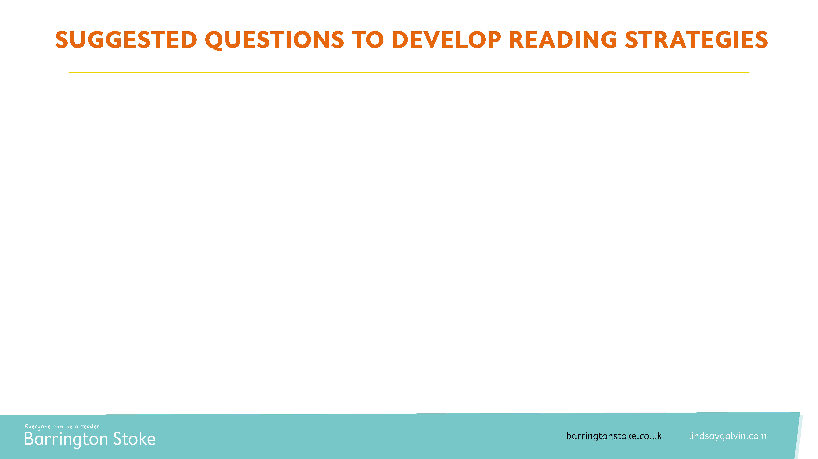
CHAPTER ONE
Explore Ann’s relationship with her siblings.
Do you think they have positive relationships with each other?
  Why do you think this?
  What evidence is there in the text to support this?
How would you describe each of the siblings?
  What characteristics or personality traits do they have?
  How are they similar and how are they different?
How do you think the arrival of Isaac Newton will impact their relationships?

Slide 4
CHAPTER TWO
Suggest why Isaac may have reacted the way that he did to Ann’s touch.
What does this suggest about the relationship between Ann and Isaac as the story continues?
How would this impact the story moving forward?

Slide 5
CHAPTER THREE
Discuss whether you think Ann’s grandmother would be found guilty or not guilty of being a witch.
What evidence is there to suggest that she was a witch?
  Can you find and copy evidence from the text to support this?
What do you think would have happened to her if she was found guilty? How would this have impacted Ann?

Slide 6
CHAPTER FOUR
Explain whether you think Katherine is right to suggest that Ann starts to be more careful.
Why would have Isaac in the house make Ann’s herb collecting at night more dangerous?
Are Ann’s reasons for still collecting the herbs at night worth the risk? What impact could it have if she stops collecting them at night and collects them during the day instead?

Slide 7
CHAPTERS FIVE & SIX
Explain why news of a witchfinder caused Ann and Katherine to react the way they did.
What could happen now that a witchfinder is due to arrive in town? What risks does this pose to the family?
How did the children prepare for the witchfinder to try and reduce the risk of being accused of witchcraft?

Slide 8
CHAPTERS SEVEN & EIGHT
What impression do you get of Isaac Newton from these two chapters?
What do his actions suggest about his personality traits or characteristics? Are you surprised by any of his actions? If so, why?
How do you think his actions will impact his relationship with Ann?
Predict what might happen in the next chapter.
What events in these chapters makes you think that this is what will happen?

Slide 9
CHAPTER NINE
Compare Ann and Isaac’s relationship to how it started:
What is different about their relationship now, compared to how it was at the beginning of the book?
Why do you think it has changed in this way?
How do you think this will impact the story moving forwards?

Slide 10
CHAPTERS TEN
Give your opinion on whether you agree with Ann or Isaac, regarding trying out the elixir to see if it works:
What could happen if it works and they try and tell people about the elixir now?
What could happen if they decide not to test it?
Do you think people would believe a young scholar? Why?

Slide 11
CHAPTERS ELEVEN - THIRTEEN
Do you think Ann was right to test the elixir on the bird and then administer it to Edward?
What could have happened to Edward if she had not tested it on the bird? How would this have impacted the two sisters?
How does administering the elixir to Edward put the family at risk? What else poses a threat to the family?

Slide 12
CHAPTERS FOURTEEN & FIFTEEN
Describe what effects the elixir might have had on Ann?
What evidence is there in the test to suggest it changed how Ann felt?
How do you think she got to the stone circle? Why do you think it was the stone circle that she ended up in?
Has the elixir had a different effect on Ann than the bird and Edward?

Slide 13
CHAPTER SIXTEEN
What do you think it would have been like to live during the time of the plague?
How did people try and prevent themselves from catching it?
Look at the section with Old John and Davy. How do you think they were feeling during this time? Can you find evidence to support this?
Look at the section about the apothecary. How do you think the children were feeling at this point? Why? Use evidence to support your opinion.

Slide 14
CHAPTER SEVENTEEN
Do you think Ann has done the right thing?
What would have happened if she didn’t put the elixir in the well? How would it have impacted the town?
What does it show of Ann’s character that she was willing to put herself at risk to try and save the people in the town?
What consequences have Ann’s actions had? Who has been negatively impacted by her actions?

Slide 15
CHAPTERS EIGHTEEN - TWENTY
Describe how Ann might have felt during these chapters:
How do you think she felt when she was trying to convince them that it was her and not her sister?
How did her feelings differ when she was in the prison cell? Why would she feel this way?
During the trial, did she have any similar feelings to how she felt during the other chapters? What about any different feelings? Why do you think this?

Slide 16
CHAPTERS TWENTY-ONE ONWARDS
Do you think each of the characters got the ending they deserved?
How do you feel about how it ended for the witchfinder? Do you think it was a fitting ending based on what you know about his characteristics/personality traits?
Do you think Ann should have received recognition for her work on the elixir?

Slide 17
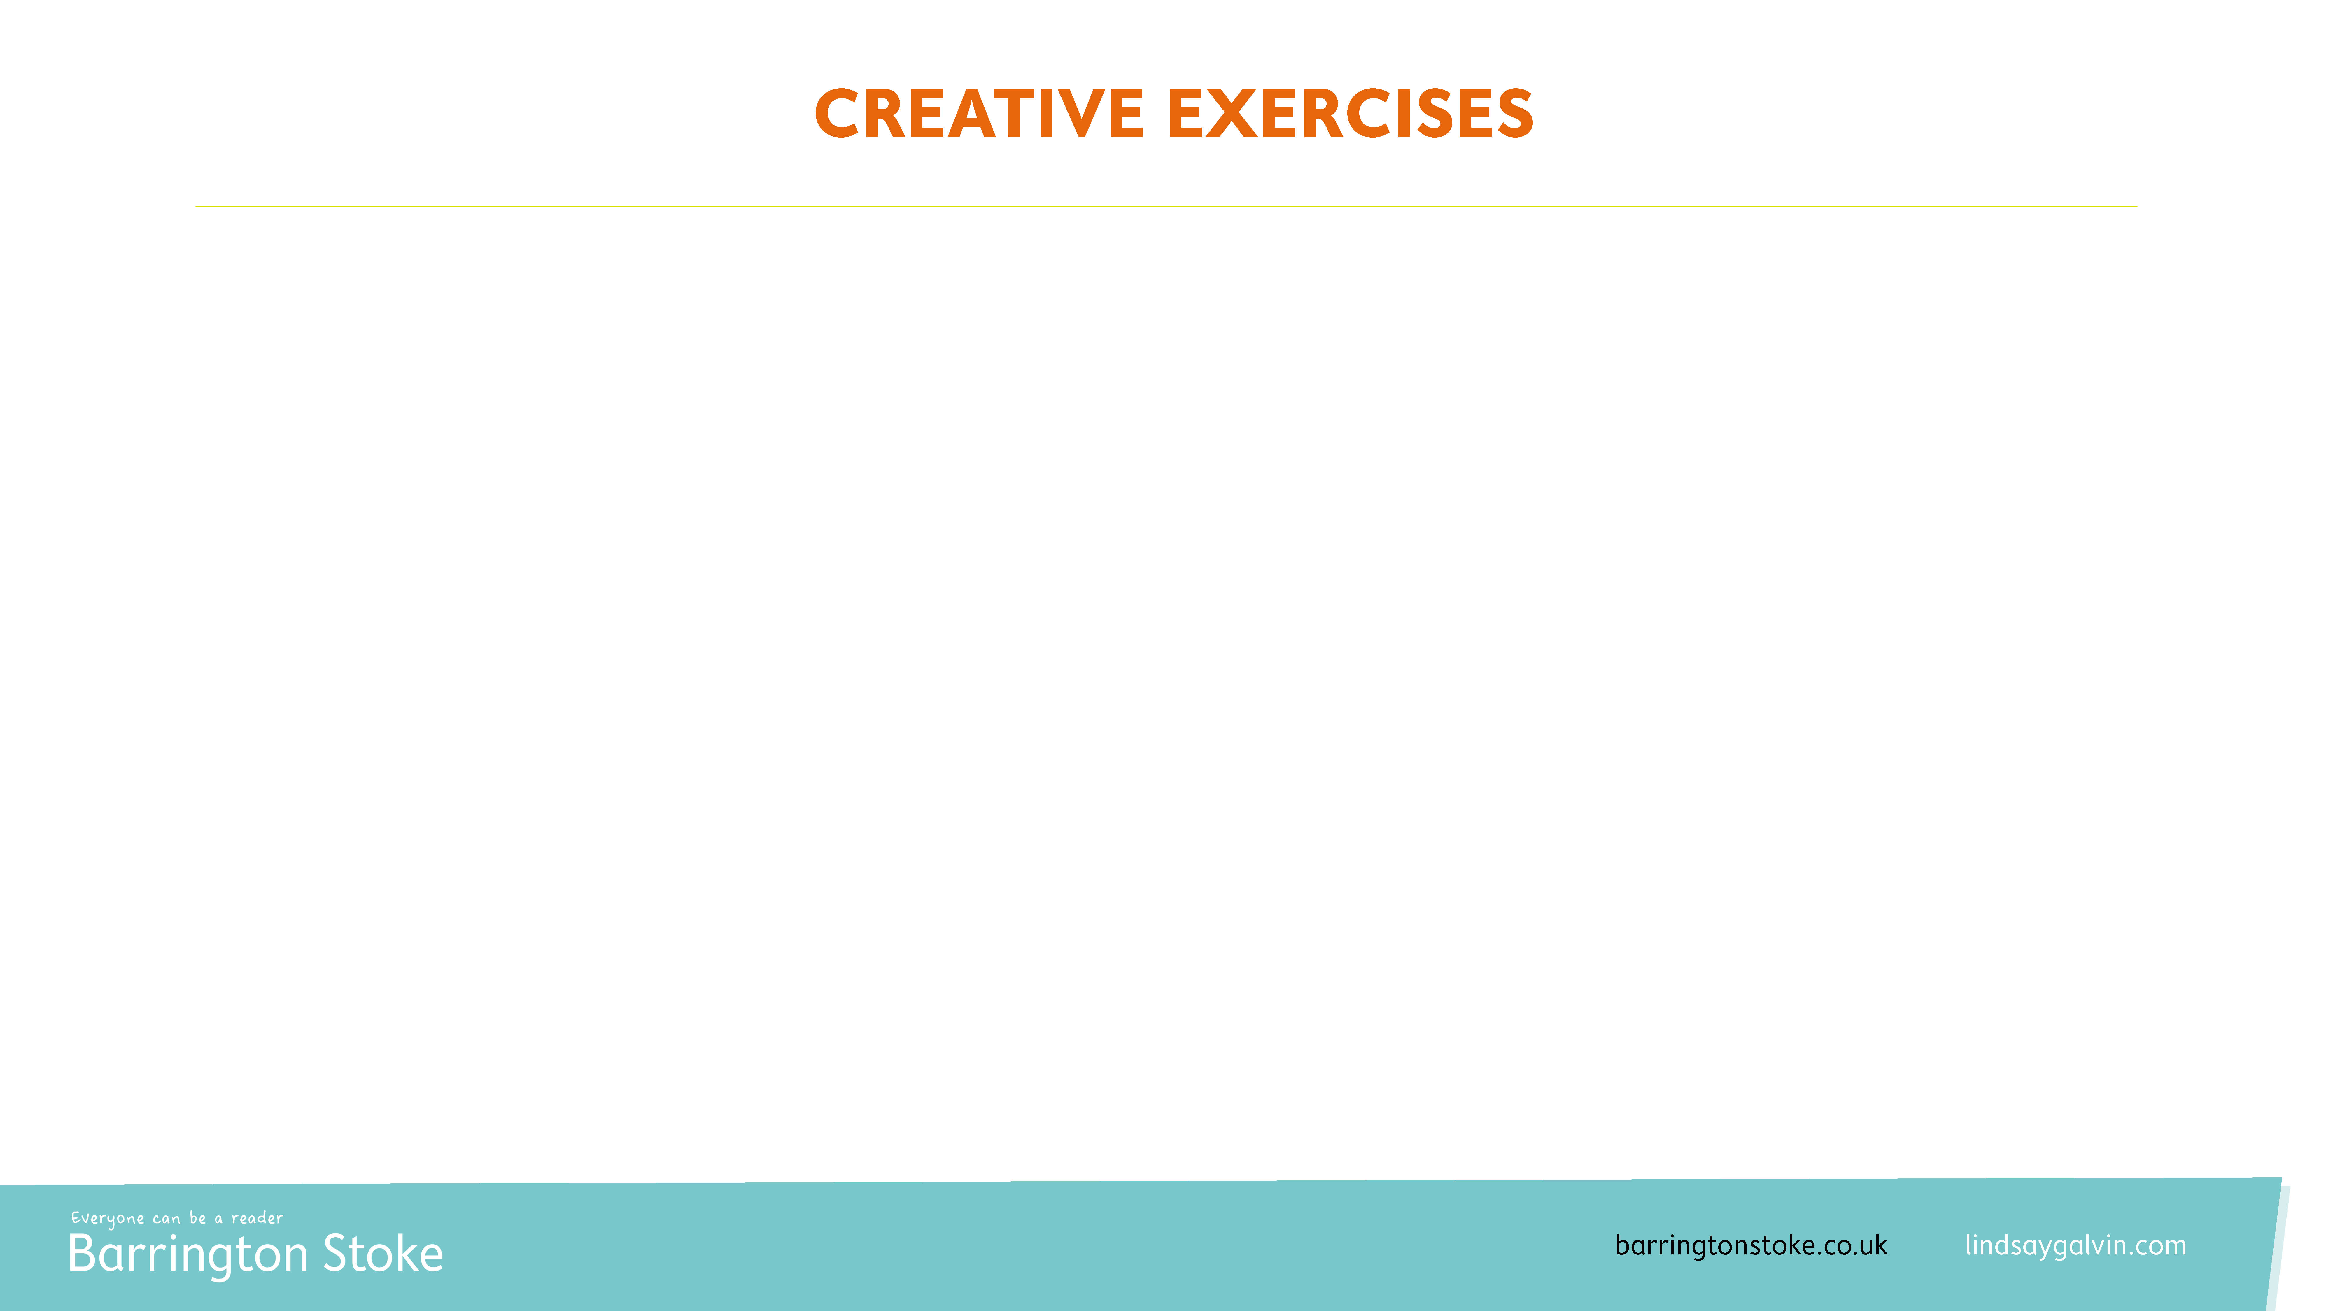
What do you think the colours represent when Ann sees them? What do you think your colour would be? Add it to the selection below and write a few sentences explaining why you chose those colours.

Slide 18

What would you put in an elixir of life? What ingredients might you decide to include? Why? Can you write some instructions on how to make it?

Slide 19

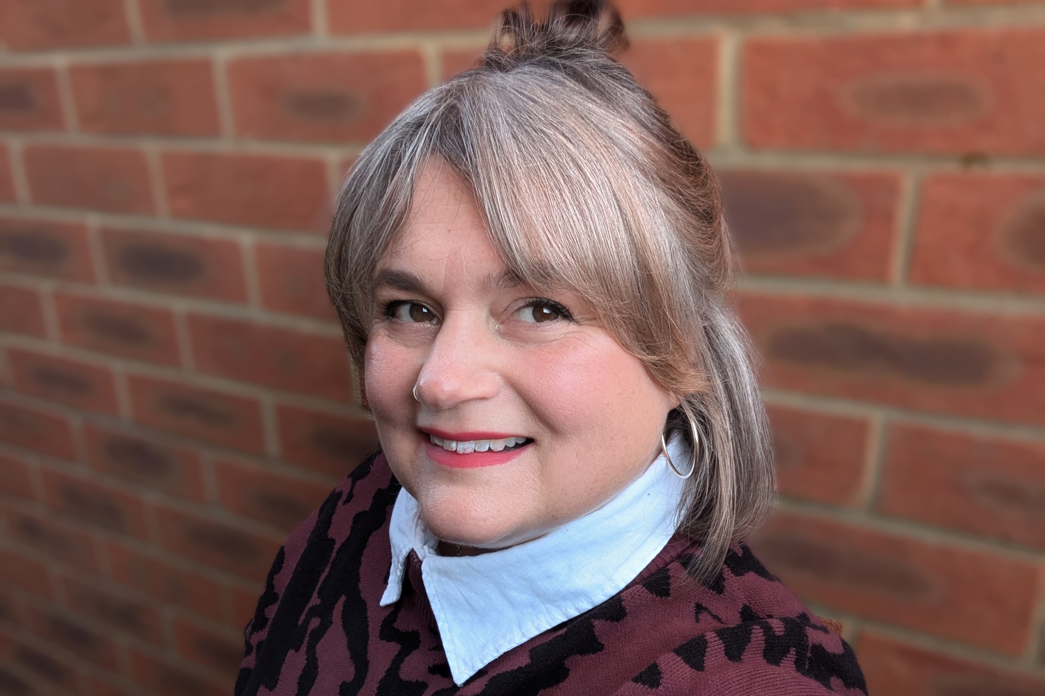
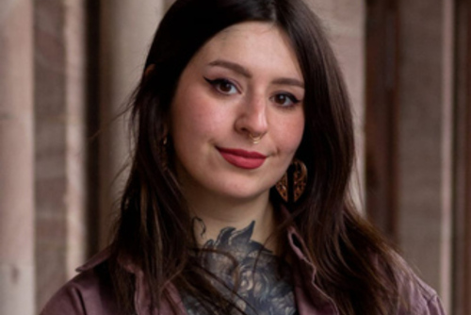
ABOUT THE AUTHOR
Former teacher Lindsay Galvin is the acclaimed author of numerous books for children, including her middle-grade titles Darwin’s Dragons, My Friend the Octopus, Call of the Titanic – an Indie book of the month – and The Great Phoenix of London, all of which brilliantly blend historical fact and fiction, combining meticulous research with page-turning storylines.
ABOUT THE ILLUSTRATOR
Kristina Kister is an illustrator and character designer from Essen, Germany. She has a soft spot for fiction and nonfiction books involving mythical creatures, the mysteries of the universe and everything magical and mysterious. Having a background as a character designer, her style is characteristic for geometric shapes and bright colour palettes.

